Slide 1
Enhancing Generalisation in a dynamic Hierarchical Reinforcement Learning Agent

Slide 2
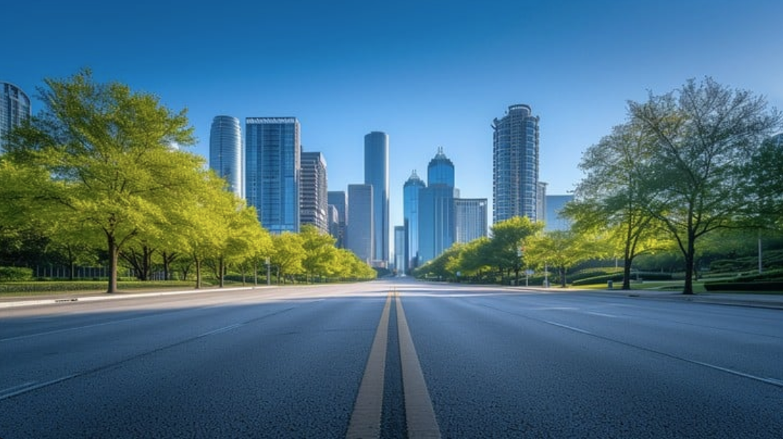

Motivations
Question?
Notes:
I’ll begin by asking you a question. We’ve heard of work in allowing cars to drive themselves. Maybe our self driving car performs well in the city we’re based in, but will it perform well if the setting changes? Objects, size of roads, animals?

Slide 3
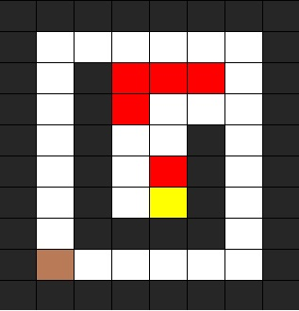
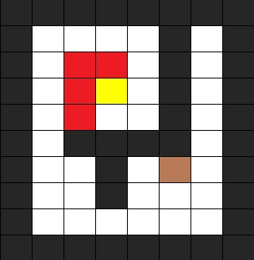
Motivations
One environment
Novel and unseen environment
Hazard
:)
.
.
.
Key
?
Door
Notes:
What about training on a simple environment like this? Explain Points of interest
If we let our little robot train here he will eventually become comfortable with it
But what about a new environment, will they understand? Where things are expected they aren’t anymore

Slide 4
Motivations
What is the problem? “Agents trained on fixed environments often fail the moment the environment changes even slightly, thus limiting the real-world applicability of current RL methods.” [1]
Why is it important? To solve “real world scenarios, where the environment will be diverse, dynamic and unpredictable.” [2]
What do we need? An agent “whose policies generalise well to novel unseen situations at deployment time, avoiding overfitting to their training environments.”
[1] A. A. J. P.-H. O. U. M. J. UCL, M. A. M. D. U. B. M. S. UCL, M. A. J. F. O. U. E. G. UCL, M. A. T. R. UCL, M. A. *Equal contribution P. March 3, and 2022 ARXIV Full paper, ‘Evolving Curricula’. Accessed: Nov. 08, 2024. [Online]. Available: https://accelagent.github.io
[2] R. Kirk, A. Zhang, E. Grefenstette, and T. Rocktäschel, ‘A Survey of Zero-shot Generalisation in Deep Reinforcement Learning’, jair, vol. 76, pp. 201–264, Jan. 2023, doi: 10.1613/jair.1.14174.
Notes:
So lets define this problem a little better.
In RL, agents as we call them are commonly trained in a single setting
Overfitting
But we need adaptability
So we need agents capable of generalising

Slide 5
Aim and Objectives
Enhancing Generalisation in a dynamic Hierarchical Reinforcement Learning Agent
Baseline evaluation of a dHRL
PCG (Procedurally Generated Content) System of producing varied ‘levels’ for training.
Evaluation of performance after generalisation techniques. (% of levels solved, time taken to solve, final score of levels).
Baseline
PCG
Evaluation
One Agent, One Level
Procedural Content Generation
Train and Evaluate
Develop a working implementation of the algorithm, train upon a singular environment. Test upon an unseen environment. Ground truth.
Develop an algorithmic system for producing varied levels for training. Multiple agents, trained on increasing amounts of PCG. Test upon an unseen environment.
Added techniques aimed at improving performance. Evaluate all agents, against each other, assessing impact of techniques on the common success metrics.
Notes:
So revisiting our aim, the goal is to look at improving this capability with a specific type of RL agent, a dHRL agent, more on that in a minute
Objectives will consist of a baseline, ground truth
A system for PCG
Evaluation with metrics

Slide 6
Background
Hierarchical Reinforcement Learning for Playing a Dynamic Dungeon Crawler Game (R. Niel and M. A. Wiering, 2018) [7]
Development of a novel dynamic Hierarchical Reinforcement Learning algorithm.
Showed increased effectiveness compared to a popular HRL of similar structure.
Future work would involve investigating effect of varied levels of training.
[7] R. Niel and M. A. Wiering, ‘Hierarchical Reinforcement Learning for Playing a Dynamic Dungeon Crawler Game’, in 2018 IEEE Symposium Series on Computational Intelligence (SSCI), Bangalore, India: IEEE, Nov. 2018, pp. 1159–1166. doi: 10.1109/SSCI.2018.8628914.
Notes:
Going over background of some important

Slide 7
Background
Quantifying Generalization in Reinforcement Learning (Cobbe et al, 2019)
Noted that commonly benchmarks in RL used the same environment for training and testing. Little insight into generalisation capability.
Addressed this using procedurally generated environments (PCG). Distinct Test/Train sets.
New environment called CoinRun, designed as a benchmark.
Investigated varying levels of PCG in training, as well as other techniques inspired by other realms of machine learning.
[8] K. Cobbe, O. Klimov, C. Hesse, T. Kim, and J. Schulman, ‘Quantifying Generalization in Reinforcement Learning’, Jul. 14, 2019, arXiv: arXiv:1812.02341. Accessed: Nov. 10, 2024. [Online]. Available: http://arxiv.org/abs/1812.02341

Slide 8
Methodology
Aim: Enhancing Generalisation in a dynamic Hierarchical Reinforcement Learning Agent
Training Enhancements:
CNN
(P)PCG & Simplified Curriculum Learning [5]
Regularisation & Stochasticity
Algorithms:
Training: dHRL
PCG: Modified Kruskal’s Algorithm [1][9]
Scope and Limitations:
Singular algorithm.
Same task.
Computational complexity.
[8] K. Cobbe, O. Klimov, C. Hesse, T. Kim, and J. Schulman, ‘Quantifying Generalization in Reinforcement Learning’, Jul. 14, 2019, arXiv: arXiv:1812.02341. Accessed: Nov. 10, 2024. [Online]. Available: http://arxiv.org/abs/1812.02341
[1] A. A. J. P.-H. O. U. M. J. UCL, M. A. M. D. U. B. M. S. UCL, M. A. J. F. O. U. E. G. UCL, M. A. T. R. UCL, M. A. *Equal contribution P. March 3, and 2022 ARXIV Full paper, ‘Evolving Curricula’. Accessed: Nov. 08, 2024. [Online]. Available: https://accelagent.github.io
[9] M. Ihsan, D. Suhaimi, M. Ramli, S. M. Yuni, and I. Maulidi, ‘Non-perfect maze generation using Kruskal algorithm’, J. Nat., vol. 21, no. 1, Feb. 2021, doi: 10.24815/jn.v21i1.18840.

Slide 9
Methodology
Experiment Setup:
Test in a grid-based dungeon-crawler game with discrete actions and states.
Evaluate baseline agent.
Evaluate agents with increasing PCG experience.
Evaluate agents with added training enhancements.
Evaluation Metrics:
Average time steps taken per level.
Percentage of levels solved.
Final score.
Validation:
Seeded level generation.
Checks for similar levels.
Comparative Analysis:
Compare agents trained with generalisation techniques against a baseline trained without them.
Assess the effectiveness of methods in enabling agents to generalise to new and varied environments.

Slide 10
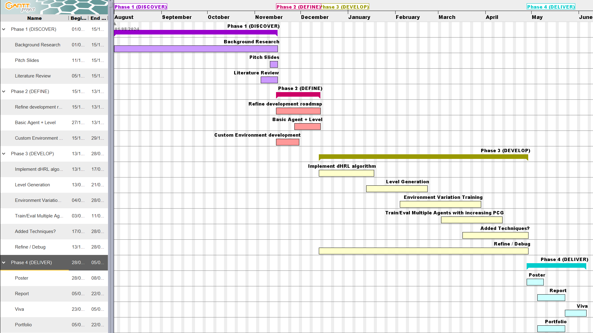

Slide 11







Resources
Hardware and Software
Algorithms
Libraries
Learning
Machine Learning
Artificial Intelligence

Slide 12
End Goal
:)

Slide 13
References
[1] A. A. J. P.-H. O. U. M. J. UCL, M. A. M. D. U. B. M. S. UCL, M. A. J. F. O. U. E. G. UCL, M. A. T. R. UCL, M. A. *Equal contribution P. March 3, and 2022 ARXIV Full paper, ‘Evolving Curricula’. Accessed: Nov. 08, 2024. [Online]. Available: https://accelagent.github.io
[2] R. Kirk, A. Zhang, E. Grefenstette, and T. Rocktäschel, ‘A Survey of Zero-shot Generalisation in Deep Reinforcement Learning’, jair, vol. 76, pp. 201–264, Jan. 2023, doi: 10.1613/jair.1.14174.
[3] A. A. J. P.-H. O. U. M. J. UCL, M. A. M. D. U. B. M. S. UCL, M. A. J. F. O. U. E. G. UCL, M. A. T. R. UCL, M. A. *Equal contribution P. March 3, and 2022 ARXIV Full paper, ‘Evolving Curricula’. Accessed: Nov. 08, 2024. [Online]. Available: https://accelagent.github.io
[4] Z. Wang, C. Chen, and D. Dong, ‘Lifelong Incremental Reinforcement Learning with Online Bayesian Inference’, IEEE Trans. Neural Netw. Learning Syst., vol. 33, no. 8, pp. 4003–4016, Aug. 2022, doi: 10.1109/TNNLS.2021.3055499.
[5] N. Justesen, R. R. Torrado, P. Bontrager, A. Khalifa, J. Togelius, and S. Risi, ‘Illuminating Generalization in Deep Reinforcement Learning through Procedural Level Generation’.
[7] R. Niel and M. A. Wiering, ‘Hierarchical Reinforcement Learning for Playing a Dynamic Dungeon Crawler Game’, in 2018 IEEE Symposium Series on Computational Intelligence (SSCI), Bangalore, India: IEEE, Nov. 2018, pp. 1159–1166. doi: 10.1109/SSCI.2018.8628914.
[8] K. Cobbe, O. Klimov, C. Hesse, T. Kim, and J. Schulman, ‘Quantifying Generalization in Reinforcement Learning’, Jul. 14, 2019, arXiv: arXiv:1812.02341. Accessed: Nov. 10, 2024. [Online]. Available: http://arxiv.org/abs/1812.02341
[9] M. Ihsan, D. Suhaimi, M. Ramli, S. M. Yuni, and I. Maulidi, ‘Non-perfect maze generation using Kruskal algorithm’, J. Nat., vol. 21, no. 1, Feb. 2021, doi: 10.24815/jn.v21i1.18840.
LOGOS:
‘Png Nvidia Geforce Gtx 780 Review - Transparent Nvidia Logo Vector,Nvidia Png - free transparent png images - pngaaa.com’. Accessed: Nov. 18, 2024. [Online]. Available: https://www.pngaaa.com/detail/844229
‘Jupyter Logo - Jupyter Png,Python Logos - free transparent png images - pngaaa.com’. Accessed: Nov. 18, 2024. [Online]. Available: https://www.pngaaa.com/detail/1971102
‘Free Transparent Python Png Download - Logo Python,Python Logo Transparent - free transparent png images - pngaaa.com’. Accessed: Nov. 18, 2024. [Online]. Available: https://www.pngaaa.com/detail/3593909
‘Free Svg Psd Png Eps Ai Icon Font - Linux Security,Linux Icon - free transparent png images - pngaaa.com’. Accessed: Nov. 18, 2024. [Online]. Available: https://www.pngaaa.com/detail/4804707

